Slide 1
Comparison between SQL and NoSQL Databases
Understanding the Differences and Use Cases

Slide 2
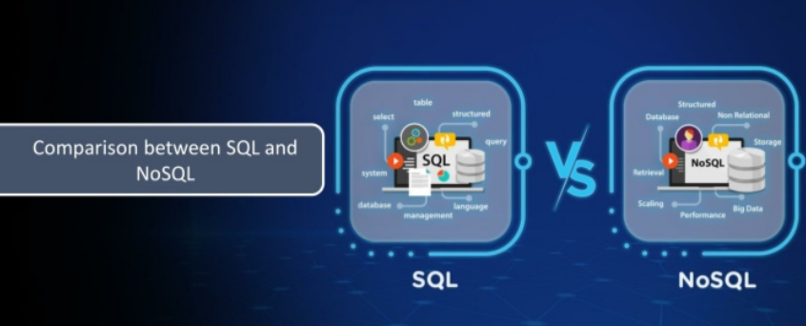

Slide 3
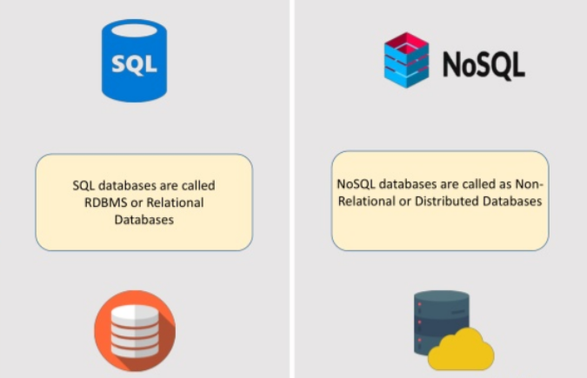

Slide 4
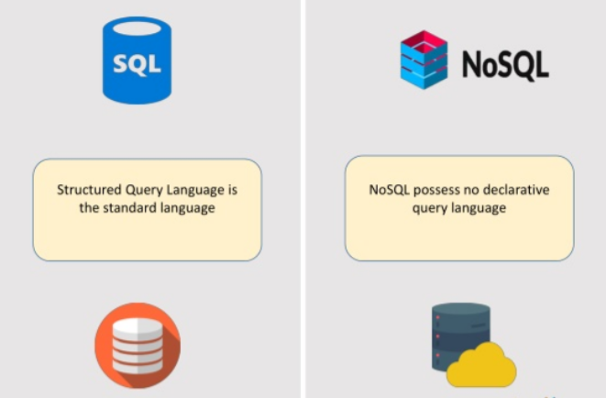

Slide 5
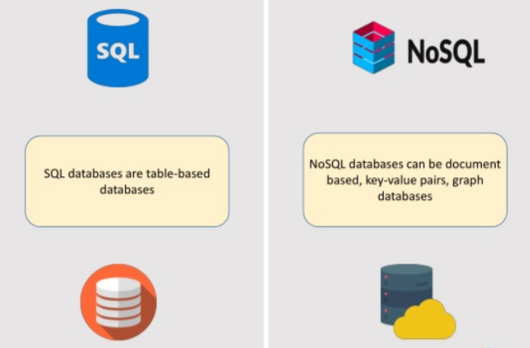

Slide 6
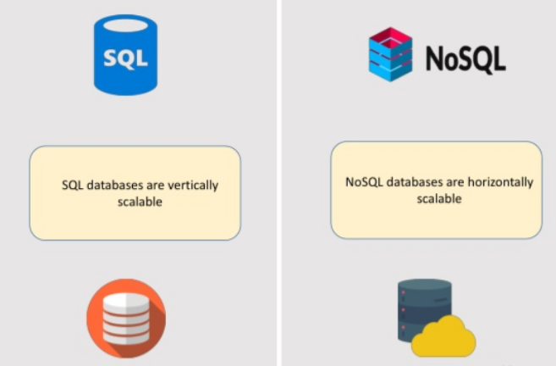

Slide 7
